Slide 1
Exploratory Data Analysis and Classification of Malware Detection
Prof. Sk. Md. Mizanur Rahman
Data-1202-02 – Data Analysis Tools analysis Group 5
Date: 2024-12-09
Akshaya Bhalikha DS – 100936892
Bhavanish S Nair – 100936855
Kapeesh Vinay Bhatt – 100940689
Gift Clara Princely Israel Jebakumar – 100924338
Harshith Nagaraja - 100922585

Slide 2
Introduction
Objective:
Perform exploratory data analysis (EDA) on the dataset to understand the features and their distributions.
Build and evaluate 3 classifiers to distinguish malware from benign samples.
Tools Used: Python, Pandas, Seaborn, Scikit-learn

Slide 3
Dataset Overview
Key Details:
Number of Samples: 100,000 (50,000 malware, 50,000 benign)
Features: Numerical system behaviour metrics
Target Variable: Binary classification (malware or benign)
Class Balance:
Malware: 50%
Benign: 50%

Slide 4
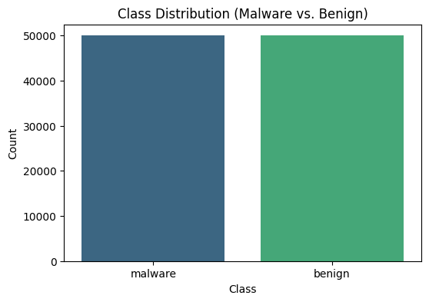
Exploratory Data Analysis (EDA)
Descriptive Statistics:
Generated for numerical features, highlighting their mean, standard deviation, minimum, and maximum values.
Class Distribution Visualization:
Balanced dataset as seen in the bar chart.

Slide 5
Correlation Heatmap
Purpose:
To identify relationships between numerical features.
Key Insights:
Most features showed weak or no significant correlation, suggesting limited redundancy.
Visualization:
A clear heatmap without strong diagonal clusters.

Slide 6
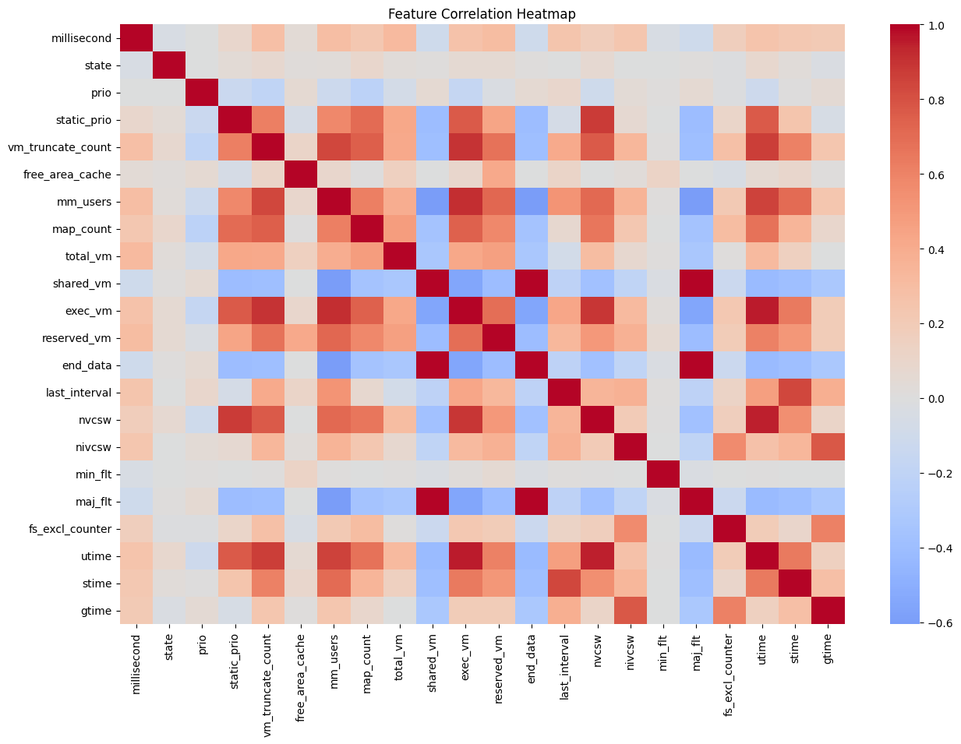
Correlation Heatmap

Slide 7
Feature Distributions
Visualization:
Histograms for numerical features revealed their distributions.
Key Observations:
Some features showed skewed or uniform distributions.
Action Taken:
Low-variance features were removed.

Slide 8
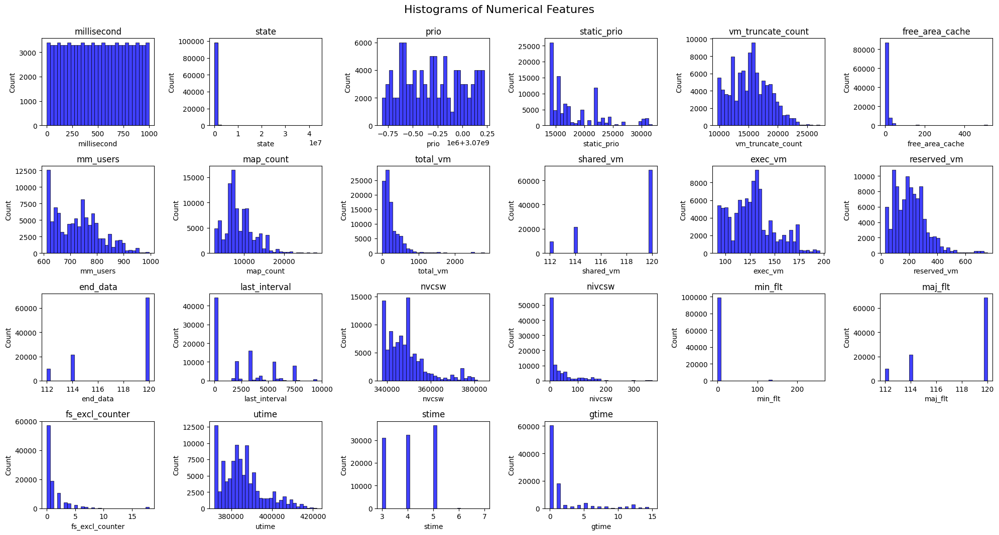
Histograms of Numerical Features

Slide 9
Model Development
Models Used:
Logistic Regression
Random Forest Classifier
K-Nearest Neighbours (KNN)
Training-Testing Split:
80% training, 20% testing, stratified by class.

Slide 10
Model Performance Metrics
Logistic Regression:
Accuracy: 74%
Benign: Precision = 80%
Recall = 64%
Malware: Precision = 70%
Recall = 84%
Observation: Performed moderately well but struggled with recall for benign samples.
Random Forest:
Accuracy: 100%
Both Classes: Precision = 100%, Recall = 100%
Observation: Perfect classification, indicating excellent performance.
K-Nearest Neighbours:
Accuracy: 100%
Both Classes: Precision = 100%, Recall = 100%
Observation: Like Random Forest, achieved perfect classification.

Slide 11
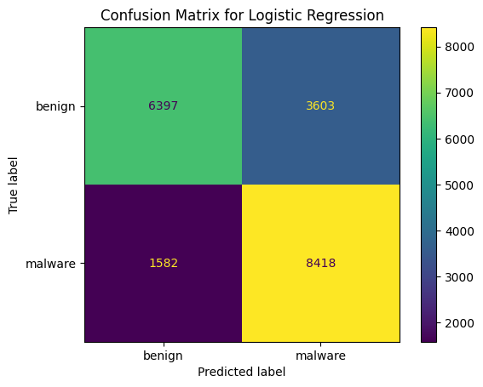
Confusion Matrices
Logistic Regression:
Highlighted more false negatives for the benign class.
Random Forest: No misclassifications.
KNN: No misclassifications.

Slide 12
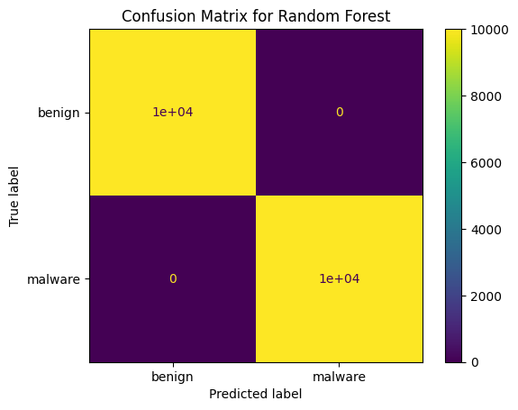
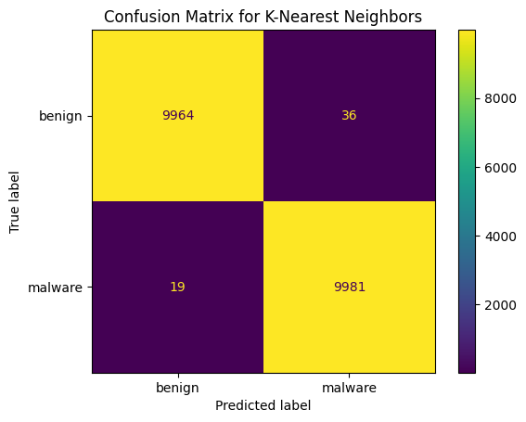
Confusion Matrices

Slide 13
Comparison of Models
Logistic Regression
Moderate accuracy, suitable for linear relationships
Random Forest:
High accuracy, robust, and ideal for real-world deployment
KNN:
It also achieved perfect classification but may be computationally intensive with larger datasets.

Slide 14
Conclusion
Summary:
Insights from EDA revealed balanced classes and weak feature correlations.
Random Forest and KNN outperformed Logistic Regression, achieving perfect scores.
Recommendation:
Random Forest is ideal due to its robustness and consistent performance.

Slide 15
Future Work
Suggestions:
Test models on unseen real-world data to confirm robustness.
Explore ensemble methods for further performance gains.
Challenges:
Address potential overfitting with Random Forest and KNN models

Slide 16
THANK YOU

